Slide 1


Automated Data Leak Prevention (DLP) System for Internal Files
Problem Statement:
Organizations struggle to prevent sensitive data from leaking through internal file shares or email systems. Manual monitoring is inefficient and error-prone. The challenge is to create an automated tool that detects the transmission of sensitive data (like passwords, PII, or intellectual property) by analyzing files and emails and takes actions such as blocking or alerting them in real time.

Slide 2
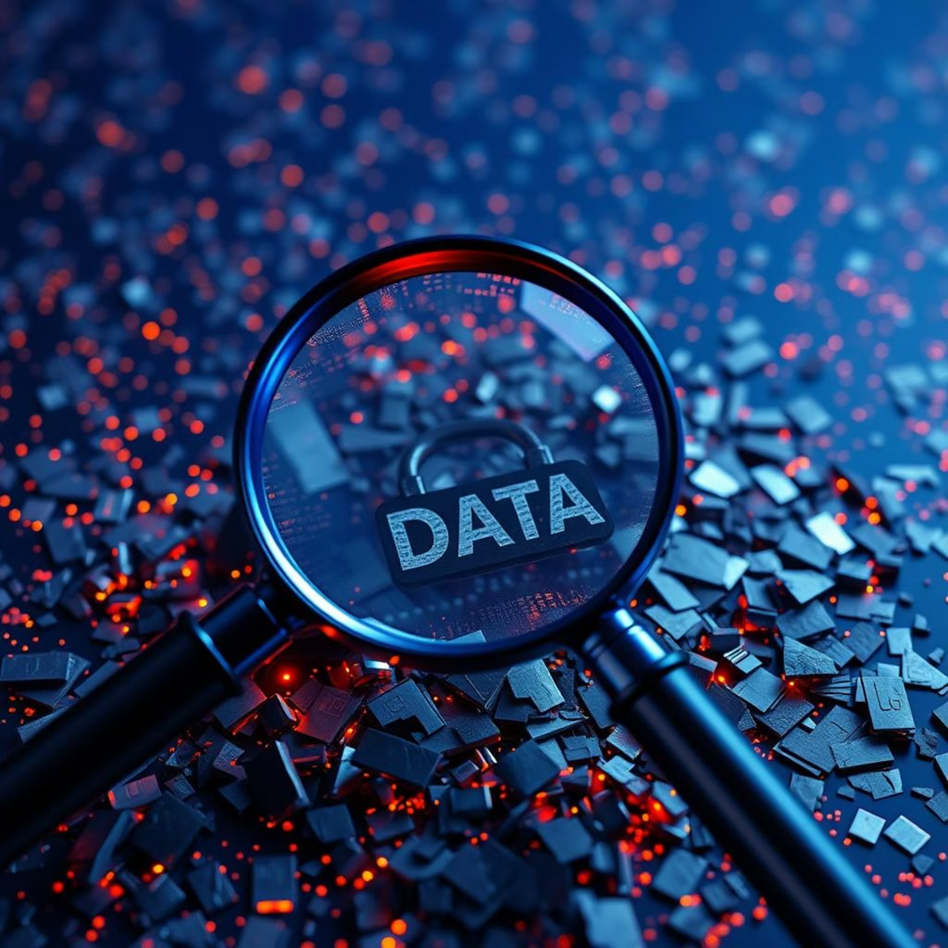
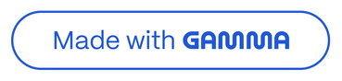
What is a Data Breach?
A data breach refers to the unauthorized access or theft of sensitive, protected, or confidential data. This can include a wide range of information, such as credit card numbers, personal identifiable information (PII) like names, addresses, and social security numbers, medical records, or even highly confidential corporate secrets and intellectual property.
Defining the Threat
These incidents are not confined to large corporations; they can affect individuals, small and medium-sized businesses (SMBs), and multinational organizations alike, proving that no entity is truly immune to cyber threats.
Reputational Damage: Erosion of customer trust, negative media coverage, and damage to brand image, which can take years to rebuild.
Operational Disruption: Downtime, recovery efforts, and potential intellectual property loss can severely hinder business continuity.
Legal & Regulatory Penalties: Fines from regulatory bodies like GDPR, CCPA, and industry-specific compliance failures.
Identity Theft: For individuals, compromised data can lead to fraud, financial ruin, and long-term personal distress.

Slide 3
The Scale of the Problem: Explosive Growth
The volume and frequency of data breaches have seen an alarming increase in recent years, transforming cybersecurity from a technical concern into a critical business imperative.
11.5B
67.5%
95%
Records Breached in 2019
Global Online Population
Breaches Involve Human Error
A vast majority (95%) of data breaches are attributed to human error, particularly issues stemming from weak or reused passwords, as highlighted by Mimecast (2025). This underscores the critical need for robust user education and awareness.
A staggering 11.5 billion records were compromised globally in 2019, a significant leap from 4.3 billion in 2018, according to MIT Sloan (2020). This represents an exponential growth in the scale of cybercriminal activity.
With 67.5% of the world's population expected to be online in 2024 (DataReportal, 2025), the attack surface for cyber threats is expanding continuously. More data, more users, more risk.
The accelerating trend in data breaches signals a clear message: organizations and individuals must adopt more sophisticated and comprehensive cybersecurity measures to protect their valuable information.

Slide 4
🏦 Case Study 1: Punjab National Bank (PNB) Scam — 2018
What Happened:
In 2018, Punjab National Bank (India’s 2nd largest public bank at that time) discovered a massive fraud worth over $1.8 billion (₹11,400–14,000 crore).
Two PNB employees at the Mumbai Brady House branch abused the SWIFT system (international payment messaging system) to issue fraudulent Letters of Undertaking (LOUs) to overseas branches of other banks.
These LOUs acted as guarantees, allowing companies linked to Nirav Modi and Mehul Choksi to get huge foreign loans without proper collateral.
The fraud went undetected for years because:
The LOUs were never recorded in PNB’s core banking system.
Internal audits and reconciliation processes were weak.
There was over-reliance on manual trust in employees handling SWIFT.
Impact:
PNB reported one of the largest banking scams in India’s history.
Bank’s share price and credibility dropped.
Sparked reforms in RBI regulations, stricter SWIFT audits, and more oversight on public banks
The Target data breach in late 2013 remains one of the most significant retail cyber incidents in history. During the busiest shopping season, hackers infiltrated Target's systems, compromising a massive amount of customer data.
Data Compromised: Hackers stole approximately 40 million credit and debit card details, alongside 70 million personal records that included names, addresses, phone numbers, and email addresses.
Attack Vector: The initial point of entry was through a third-party HVAC vendor. Hackers gained access to Target's network via phishing credentials stolen from the vendor. This was exacerbated by Target's poor network segmentation (allowing lateral movement) and outdated software.

Slide 5
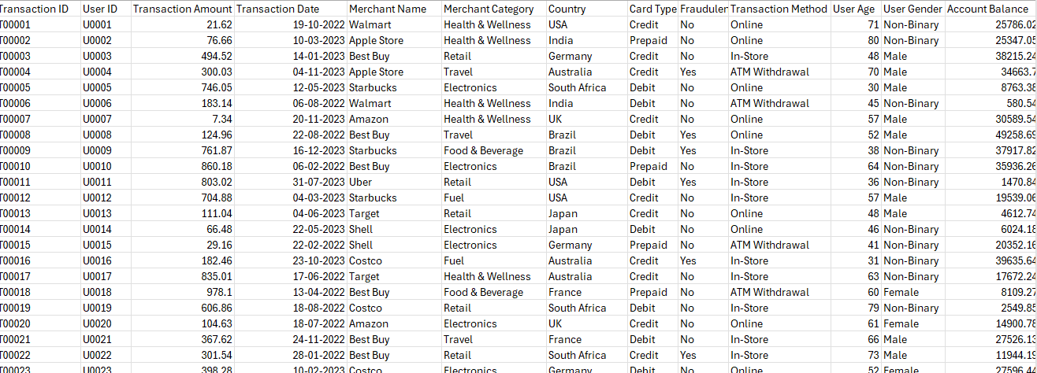

Slide 6
Common Causes of Data Breaches
Understanding the root causes of data breaches is the first step towards effective prevention. While attack methods evolve, several common vulnerabilities and tactics consistently lead to successful compromises.
Phishing & Social Engineering
Insider Threats
Outdated Software & Weak Passwords
These attacks trick employees or vendors into revealing credentials or installing malware. Modern phishing emails are highly sophisticated, often mimicking legitimate communications perfectly.
Whether accidental (e.g., misconfigured settings, lost devices) or malicious (e.g., disgruntled employees stealing data), insider actions are a significant cause of data leaks. This often involves employees with privileged access.
Unpatched vulnerabilities in operating systems and applications are prime targets. Furthermore, weak, easily guessable, or reused passwords provide easy entry points for attackers. Many organizations still struggle with enforcing strong password policies.
Lack of Network Segmentation
Vendor & Third-Party Oversight
When networks are flat and undifferentiated, a breach in one area can quickly spread throughout the entire system. Proper segmentation isolates sensitive data, limiting an attacker's lateral movement once inside.
As seen with Target, breaches often originate from third-party vendors with less robust security. Organizations must extend their security scrutiny to their entire supply chain, including cloud service providers.

Slide 7
How To proceed with Problem Statement
1. User Action/Input
When a user attempts to send or share a file/email, your DLP system intercepts this action before it proceeds to its destination.
2. DLP Module Interception
The intercepted file/email is passed directly to your DLP processing pipeline, ensuring that every item is checked regardless of its origin or type.
3. Detection Engine (Regex Scan)
Perform rule-based scanning using regular expressions (regex) to detect known patterns of sensitive data (e.g., credit card numbers, ID numbers, passwords).
4. Machine Learning (ML) Classifier (Optional, but Valuable)
For heightened accuracy, input the content into an ML model trained to recognize sensitive data in context—detecting risky content that regex might miss (such as subtle leakage or paraphrased confidential data).
5. Policy Engine and Decision Making
The system processes results from both the detection engine and ML classifier:
If sensitive information is detected: Block the transmission and/or Alert the appropriate user/admin.
If content is clean: Allow transmission as normal.
6. Action Enforcement
Execute the decision made by the policy engine:
Block: Stop transmission.
Alert: Notify the user and/or admin, providing details.
Allow: Proceed to send or share the file/email.
7. Audit Logging
Log every detection, decision, and action—especially when blocking or alerting—into a persistent audit log. This supports compliance checks and future incident reviews.
The Weakest Link
Password Reuse & Phishing: A staggering 95% of data breaches are linked to human error, with password reuse and successful phishing attacks being leading contributors. Users often recycle passwords across multiple platforms, meaning one compromised credential can unlock numerous accounts.
Outdated Policies: Security policies like forced password resets every 90 days, once thought to improve security, have been shown to weaken it. Users tend to create simpler, predictable passwords or merely increment existing ones, making them easier for attackers to guess.
AI-Driven Phishing: The rise of Artificial Intelligence (AI) has empowered attackers to craft highly personalized and convincing phishing emails, making them even harder for users to detect. These sophisticated attacks can mimic known contacts or legitimate services, exploiting trust.
"Click First, Think Later": The fast-paced digital environment often leads to impulsive actions, such as clicking on suspicious links or downloading malicious attachments, without proper scrutiny.

Slide 8
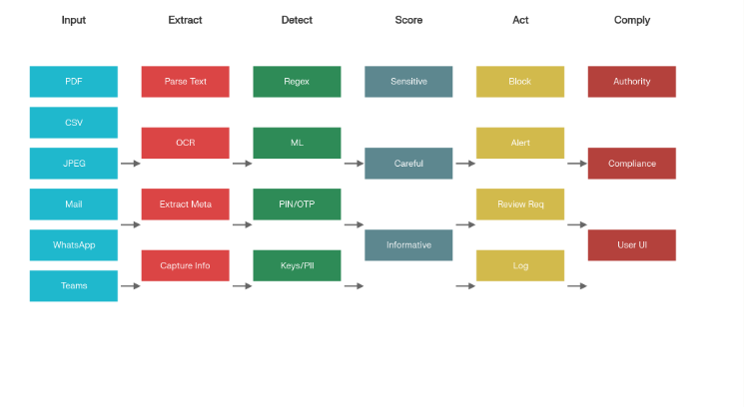

Slide 9
Lessons Learned & Prevention Strategies
Mitigating the risk of data breaches requires a comprehensive, multi-layered approach that integrates technology, policy, and human education. Here are key prevention strategies:
01
02
Implement Strong Authentication
Regular Software Updates & Patching
Enforce multi-factor authentication (MFA) for all systems and accounts. Encourage the use of strong, unique passwords, and consider deploying password managers to assist users.
Maintain a rigorous schedule for patching and updating all software, operating systems, and firmware. Unpatched vulnerabilities are a primary attack vector.
03
04
Network Segmentation & Access Control
Employee Cybersecurity Training
Divide networks into smaller segments to contain potential breaches. Implement strict least privilege access controls, ensuring users and systems only have access to resources necessary for their function.
Conduct regular and engaging cybersecurity awareness training sessions. Focus on recognizing phishing, social engineering tactics, and secure data handling practices.
05
06
Incident Response & Recovery Plans
Vendor Security Management
Develop and regularly test a comprehensive incident response plan. This includes identification, containment, eradication, recovery, and post-incident analysis to build organizational resilience.
Establish robust processes for assessing and managing the cybersecurity risks of third-party vendors and suppliers. Ensure their security standards align with your own.

Slide 10
Conclusion: The Fight Against Data Breaches
Data breaches are not merely isolated incidents but a systemic challenge in our digital age. The increasing scale and sophistication of these attacks demand a continuous and adaptive response from individuals and organizations alike.
Escalating Threat Landscape: Data breaches are escalating in both scale and sophistication, driven by advanced tactics and the ever-expanding digital footprint of individuals and businesses. The threat actor landscape is diverse, ranging from individual hackers to state-sponsored groups.
Human Element as the Critical Link: Despite technological advancements, human error remains the most significant vulnerability. This underscores that effective cybersecurity is as much about people as it is about technology. Education, awareness, and fostering a strong security culture are paramount.
Holistic Defense Strategy: Robust technical controls—such as MFA, regular patching, and network segmentation—must be combined with proactive policies and continuous employee training. A layered security approach offers the best defense.
Cybersecurity as an Ongoing Journey: The battle against data breaches is not a one-time fix but a continuous process. Organizations must commit to ongoing vigilance, regular risk assessments, and adaptive strategies to stay ahead of evolving threats. Stay vigilant, stay prepared.
Thank you.

